Slide 1
Introduction to Unsupervised Learning Clustering(K-means)

Slide 2
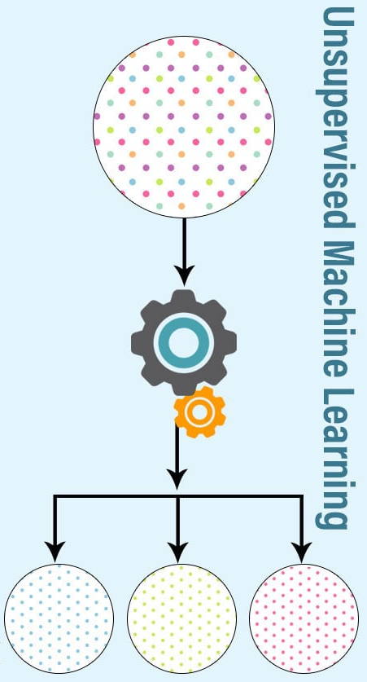
Unsupervised Learning
Branch of ML deals with unlabeled data
Algorithms are tasked to find hidden patterns without prior knowledge about the data
Model only takes input data and identifies groups or pattern on its own.
Detect patterns e.g. in
Group emails
Customer shopping patterns
Regions of images

Slide 3
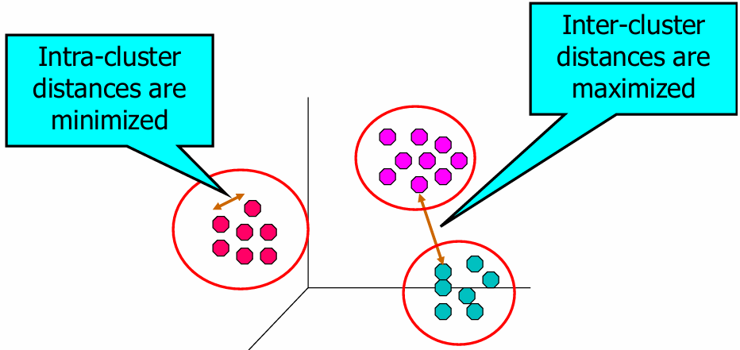
Clustering
Cluster: a collection of data objects
Similar to one another within the same cluster
Dissimilar to the objects in other clusters
Clustering is the task of dividing a population into smaller groups such that samples within the same group are more similar to each other than to those in other groups.

Slide 4
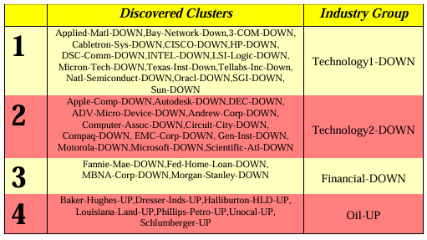
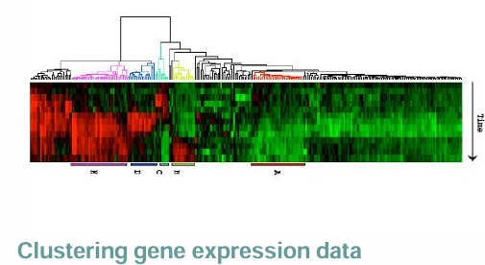
Applications
Information Retrieval: Group related documents for browsing
Finance: Group stocks with similar price fluctuations or particular industry
Marketing: Help marketers discover distinct groups in their customer bases, and develop targeted marketing programs

Slide 5
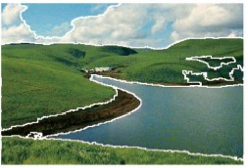
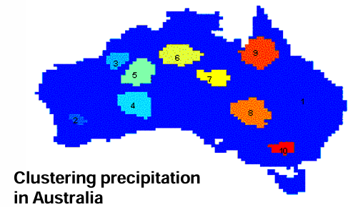
Applications
Image segmentation: Break up the image into meaningful or perceptually similar regions
Summarization: Reduce the size of large data sets

Slide 6
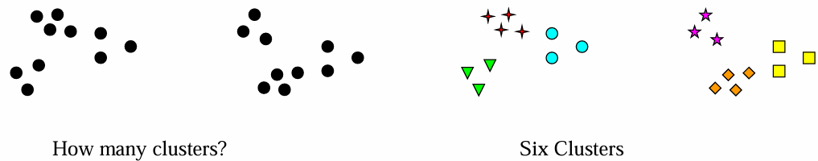
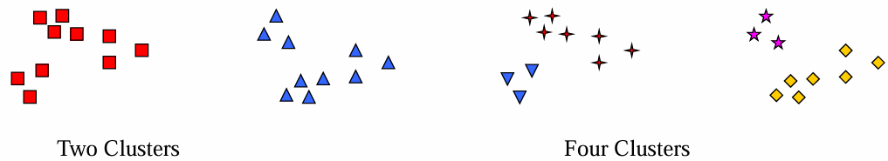
Cluster can be ambiguous
Clustering results are crucially dependent on the measure of similarity (or distance) between “points” to be clustered

Slide 7




Cluster can be ambiguous
Clustering results are crucially dependent on the measure of similarity (or distance) between “points” to be clustered

Slide 8


Cluster can be ambiguous
Clustering results are crucially dependent on the measure of similarity (or distance) between “points” to be clustered

Slide 9
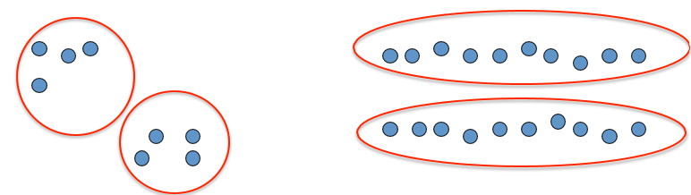
Cluster can be ambiguous
Clustering results are crucially dependent on the measure of similarity (or distance) between “points” to be clustered
How can we measure the Quality of Clusters?

Slide 10
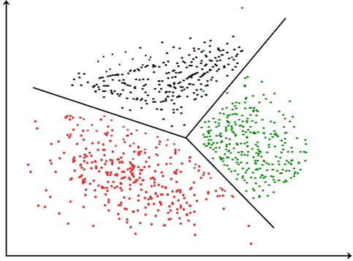
Quality of Clustering
There is usually a separate “quality” function that measures the “goodness” of a cluster.
It is hard to define “similar enough” or “good enough”
The answer is typically highly subjective

Slide 11
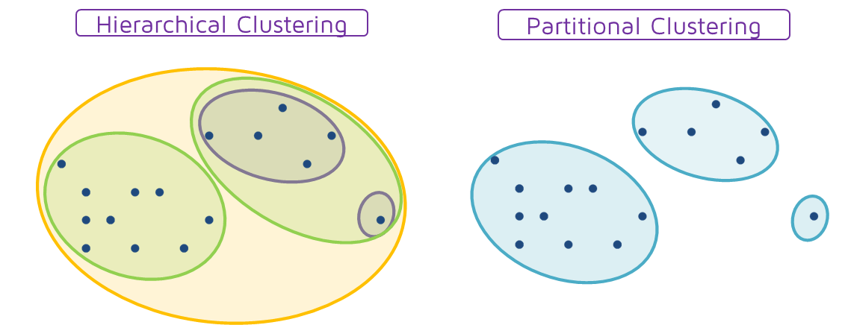
Cluster Analysis
Hierarchical VS Partitioning clustering:

Slide 12
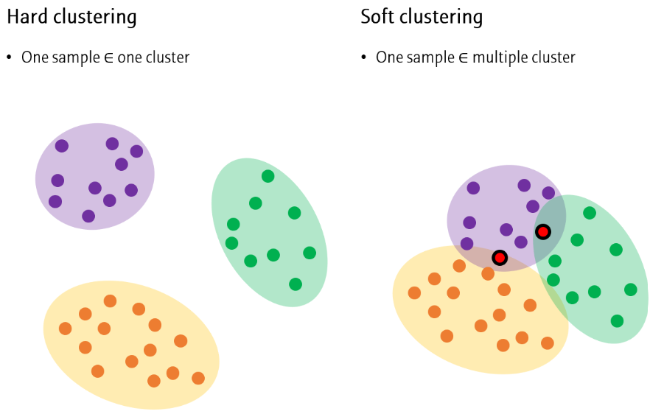
Cluster Analysis
Separation of clusters

Slide 13
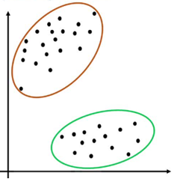
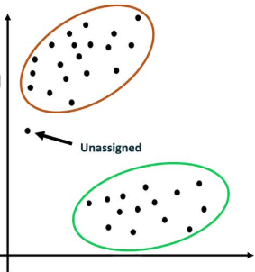
Cluster Analysis
Clustering space
Complete: Every data point is assigned to exactly one cluster and no data point is left out of the clustering process
Partial: Some data points are not assigned to any cluster. Its useful when there are outliers.

Slide 14


Cluster Analysis
Heterogeneous vs Homogeneous
Homogeneous: Data points within the same group are similar in their attributes or characteristics. Example: A cluster of images of dogs or cat in a dataset of images
Heterogeneous: Data points are clustered together because they share some common characteristics. Example: Customers of different demographics cluster together based on the purchasing history.

Slide 15
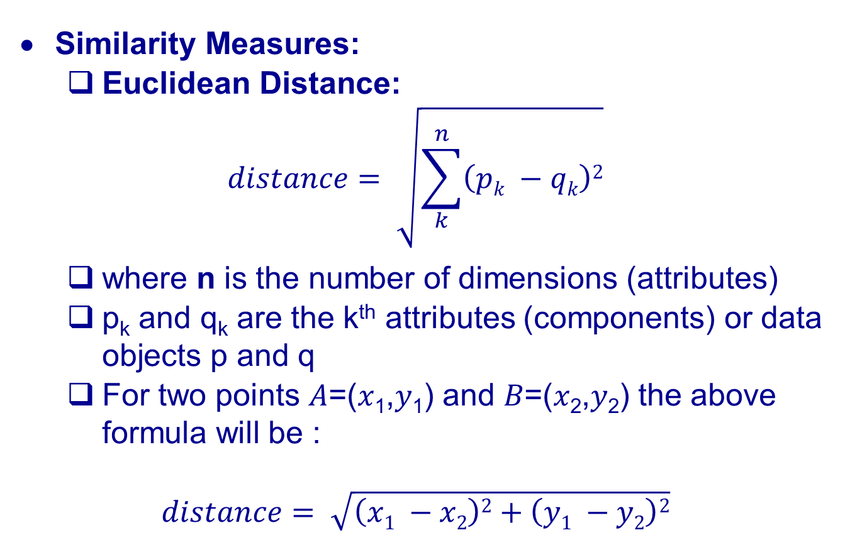
Cluster Analysis
Similarity Measures:
Euclidean Distance:
$$distance= \sqrt{\sum_{k}^{n}{\left(pk −qk\right)2}}$$
where n is the number of dimensions (attributes)
p_{k} and q_{k} are the k^{th} attributes (components) or data objects p and q
For two points 𝐴=(𝑥₁,𝑦₁) and 𝐵=(𝑥₂,𝑦₂) the above formula will be :
$$distance= \sqrt{\left(x1 −x2\right)2+\left(y1 −y2\right)2}$$

Slide 16
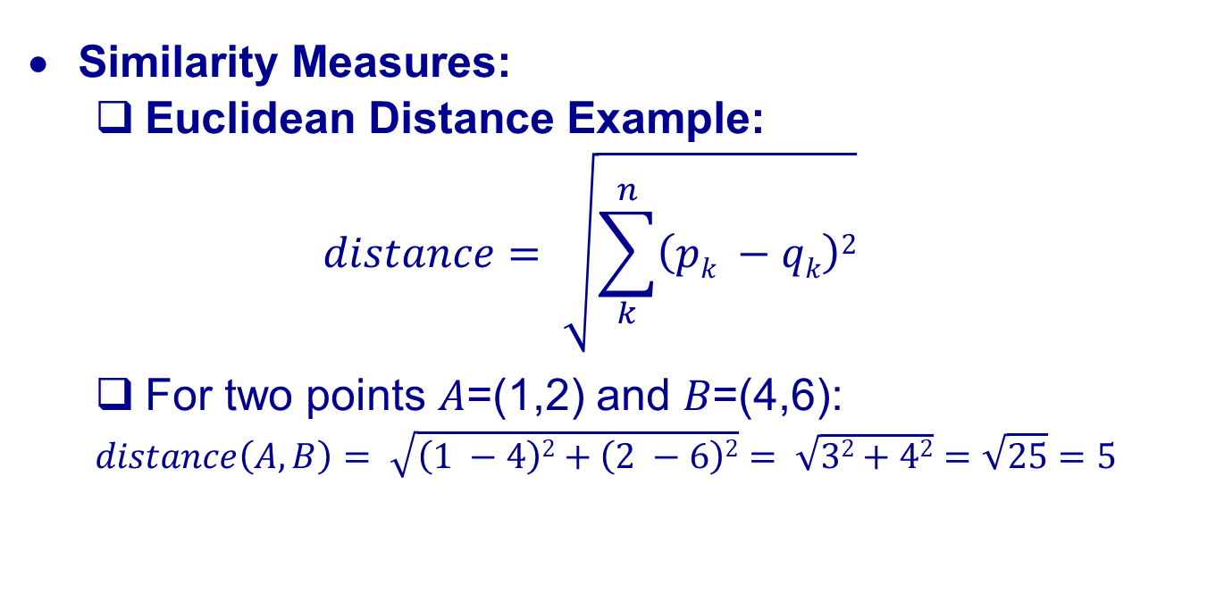
Cluster Analysis
Similarity Measures:
Euclidean Distance Example:
$$distance= \sqrt{\sum_{k}^{n}{\left(pk −qk\right)2}}$$
For two points 𝐴=(1,2) and 𝐵=(4,6):
$$distance\left(A,B\right)= \sqrt{\left(1 −4\right)2+\left(2 −6\right)2}= \sqrt{32+42}=\sqrt{25}=5$$

Slide 17
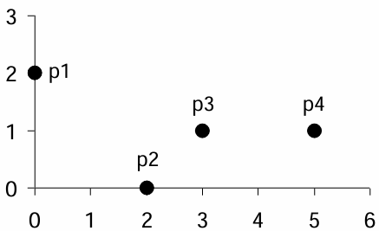
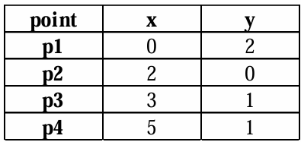
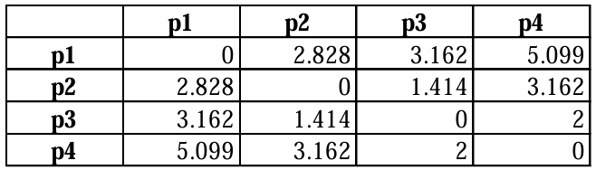
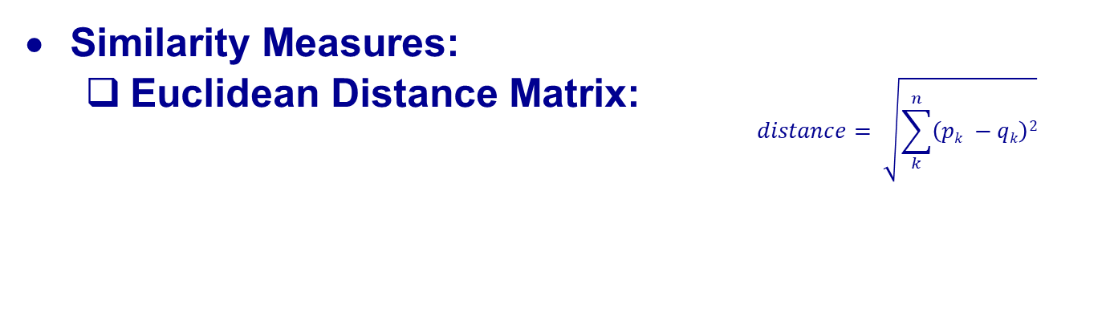
Cluster Analysis
Similarity Measures:
Euclidean Distance Matrix:
$$distance= \sqrt{\sum_{k}^{n}{\left(pk −qk\right)2}}$$

Slide 18
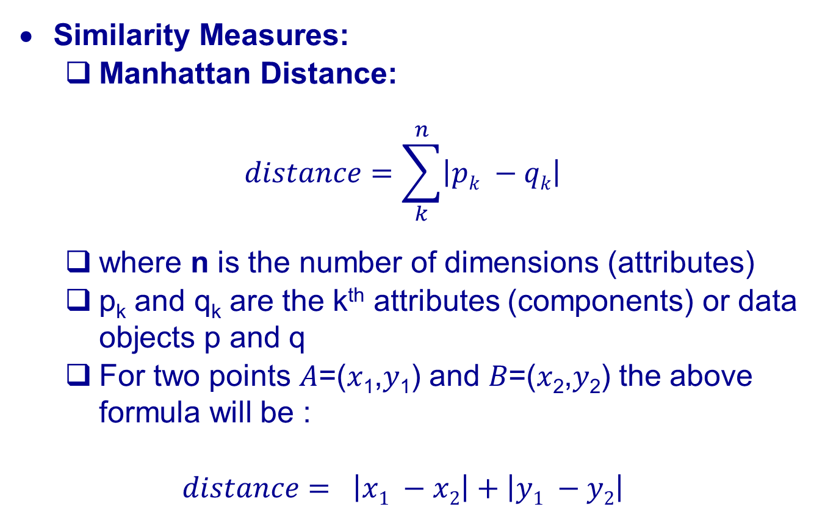
Cluster Analysis
Similarity Measures:
Manhattan Distance:
$$distance=\sum_{k}^{n}{\left|pk −qk\right|}$$
where n is the number of dimensions (attributes)
p_{k} and q_{k} are the k^{th} attributes (components) or data objects p and q
For two points 𝐴=(𝑥₁,𝑦₁) and 𝐵=(𝑥₂,𝑦₂) the above formula will be :
$$distance= \left|x1 −x2\right|+\left|y1 −y2\right|$$

Slide 19
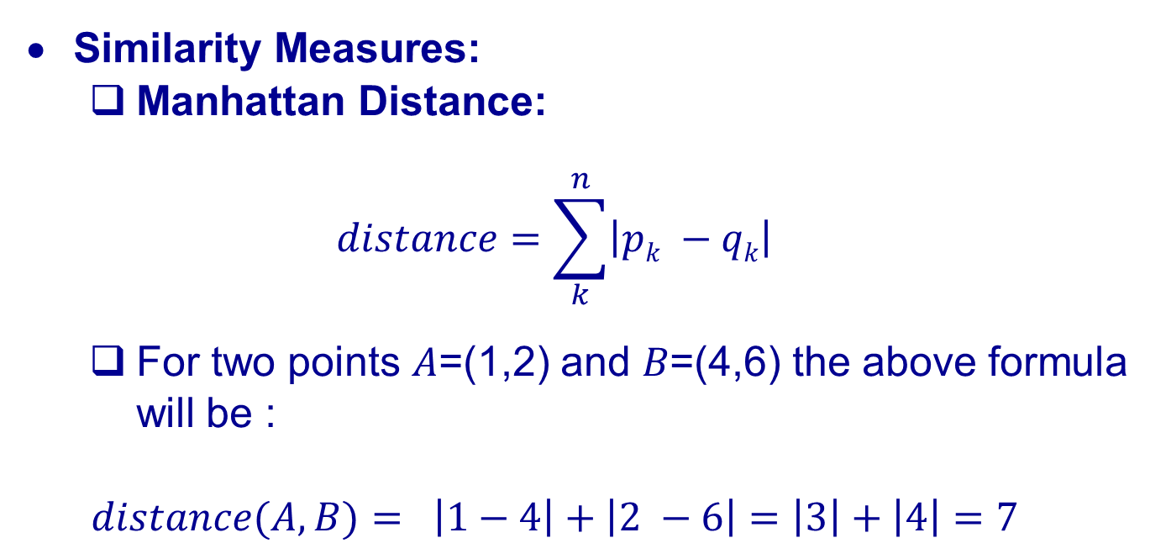
Cluster Analysis
Similarity Measures:
Manhattan Distance:
$$distance=\sum_{k}^{n}{\left|pk −qk\right|}$$
For two points 𝐴=(1,2) and 𝐵=(4,6) the above formula will be :
$$distance(A,B)= \left|1−4\right|+\left|2 −6\right|=\left|3\right|+\left|4\right|=7$$

Slide 20
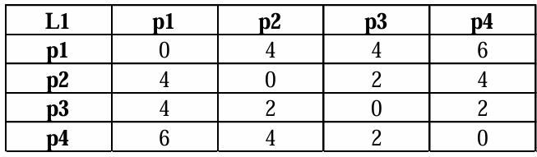
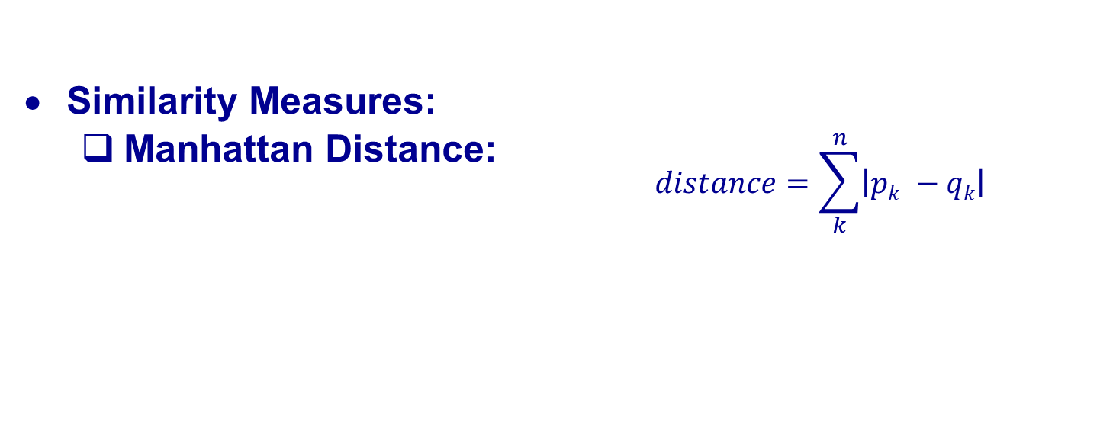
Cluster Analysis
Similarity Measures:
Manhattan Distance:
$$distance=\sum_{k}^{n}{\left|pk −qk\right|}$$

Slide 21
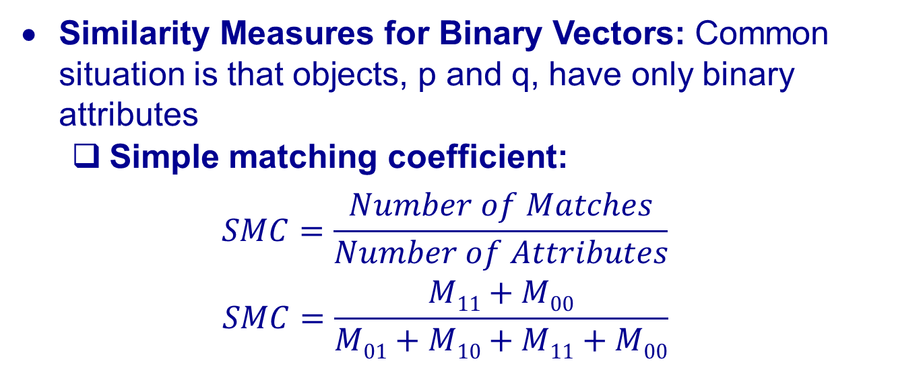
Cluster Analysis
Similarity Measures for Binary Vectors: Common situation is that objects, p and q, have only binary attributes
Simple matching coefficient:
$$SMC=\frac{Number of Matches}{Number of Attributes}$$
$$SMC=\frac{M11+M00}{M01+M10+M11+M00}$$
Object _{i} | Object _{j}
 | 1 | 0 | Sum
1 | M₁₁ | M₁₀ | M₁₁+ M₁₀
0 | M₀₁ | M₀₀ | M₀₁+ M₀₀
Sum | M₁₁ + M₀₁ | M₁₀ + M₀₀ | M₁₁ + M₀₁+M₁₀ + M₀₀

Slide 22

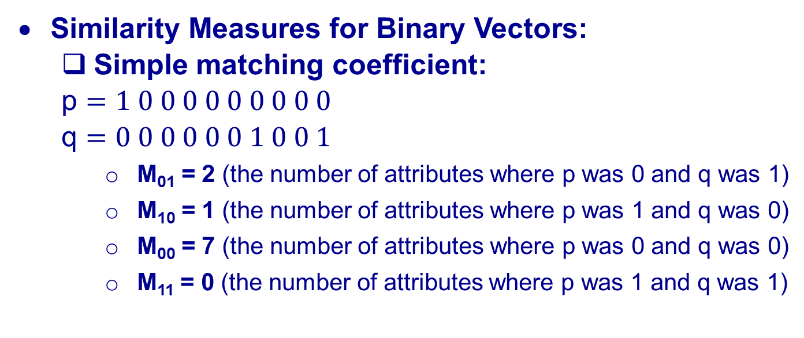

Cluster Analysis
Similarity Measures for Binary Vectors:
Simple matching coefficient:
p $=1 0 0 0 0 0 0 0 0 0$
q $=0 0 0 0 0 0 1 0 0 1$
M₀₁ = 2 (the number of attributes where p was 0 and q was 1)
M₁₀ = 1 (the number of attributes where p was 1 and q was 0)
M₀₀ = 7 (the number of attributes where p was 0 and q was 0)
M₁₁ = 0 (the number of attributes where p was 1 and q was 1)
$$SMC=\frac{M11+M00}{M01+M10+M11+M00}$$
$$SMC=\frac{0+7}{2+1+0+7}=0.7$$

Slide 23
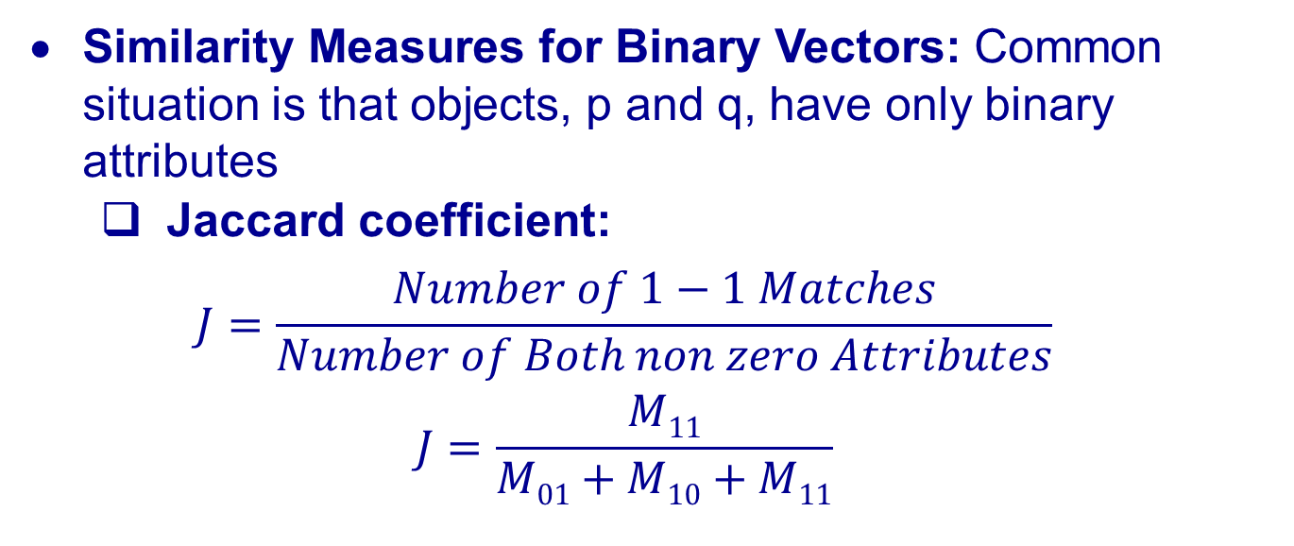
Cluster Analysis
Similarity Measures for Binary Vectors: Common situation is that objects, p and q, have only binary attributes
Jaccard coefficient:
$$J=\frac{Number of 1−1 Matches}{Number of Both non zero Attributes}$$
$$J=\frac{M11}{M01+M10+M11}$$
Object _{i} | Object _{j}
 | 1 | 0 | Sum
1 | M₁₁ | M₁₀ | M₁₁+ M₁₀
0 | M₀₁ | M₀₀ | M₀₁+ M₀₀
Sum | M₁₁ + M₀₁ | M₁₀ + M₀₀ | M₁₁ + M₀₁+M₁₀ + M₀₀

Slide 24

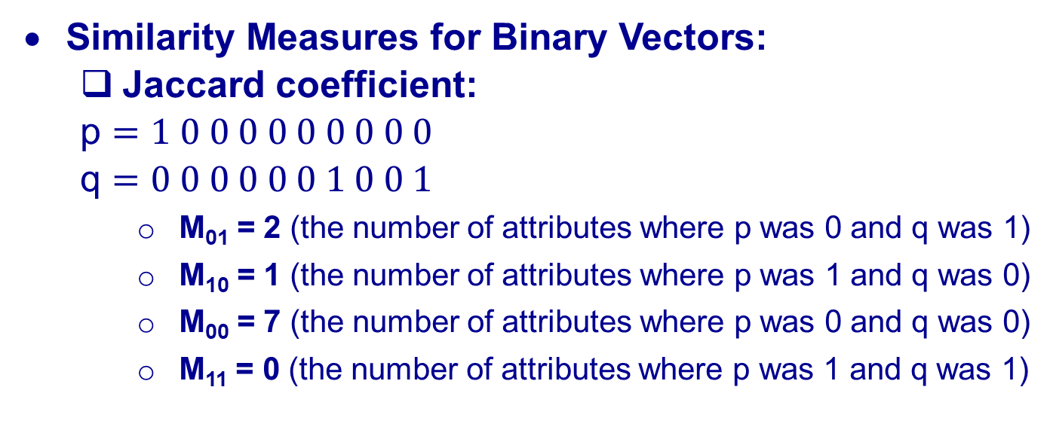

Cluster Analysis
Similarity Measures for Binary Vectors:
Jaccard coefficient:
p $=1 0 0 0 0 0 0 0 0 0$
q $=0 0 0 0 0 0 1 0 0 1$
M₀₁ = 2 (the number of attributes where p was 0 and q was 1)
M₁₀ = 1 (the number of attributes where p was 1 and q was 0)
M₀₀ = 7 (the number of attributes where p was 0 and q was 0)
M₁₁ = 0 (the number of attributes where p was 1 and q was 1)
$$J=\frac{M11}{M01+M10+M11}$$
$$J=\frac{0}{2+1+0}=0$$

Slide 25
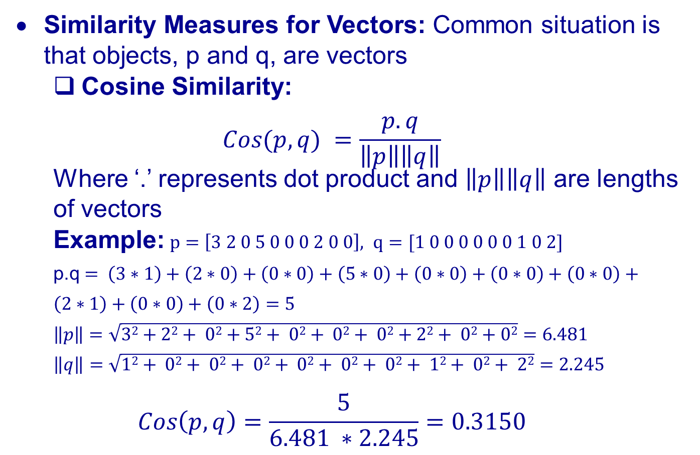
Cluster Analysis
Similarity Measures for Vectors: Common situation is that objects, p and q, are vectors
Cosine Similarity:
$$Cos(p,q) =\frac{p.q}{\left\|p\right\|\left\|q\right\|}$$ Where ‘.’ represents dot product and $\left\|p\right\|\left\|q\right\|$ are lengths of vectors
Example:$p=\left[3 2 0 5 0 0 0 2 0 0\right], q=[1 0 0 0 0 0 0 1 0 2]$
p.q $= \left(3∗1\right)+\left(2∗0\right)+\left(0∗0\right)+\left(5∗0\right)+\left(0∗0\right)+\left(0∗0\right)+\left(0∗0\right)+\left(2∗1\right)+\left(0∗0\right)+\left(0∗2\right)=5$
$$\left\|p\right\|=\sqrt{32+22+ 02+52+ 02+ 02+ 02+22+ 02+02}=6.481$$
$$\left\|q\right\|=\sqrt{12+ 02+ 02+ 02+ 02+ 02+ 02+ 12+ 02+ 22}=2.245$$
$$Cos\left(p,q\right)=\frac{5}{6.481 ∗2.245}=0.3150$$

Slide 26
K-Means
An iterative clustering algorithm
Each cluster is associated with a centroid(center point)
Each point is assigned to the cluster with the closest centroid
Number of clusters, K, must be specified
Algorithm
Initialize: Pick K random points as cluster centers
Repeat:
Assign data points to closest cluster center
Change the cluster center to the average of its assigned points
Until The centroids don’t change

Slide 27
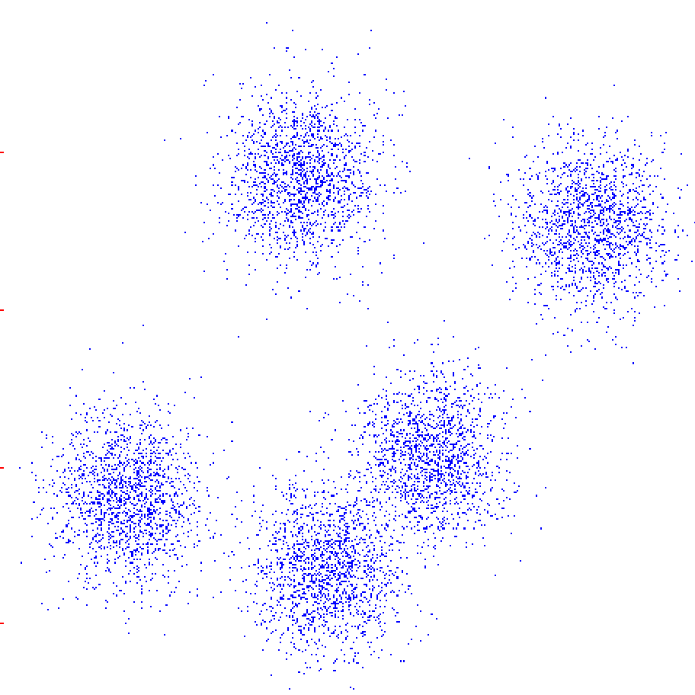
K-Means
Algorithm
Initialize: Pick K random points as cluster centers
Repeat:
Assign data points to closest cluster center
Change the cluster center to the average of its assigned points
Until The centroids don’t change

Slide 28
K-Means
Algorithm
Initialize: Pick K random points as cluster centers
Repeat:
Assign data points to closest cluster center
Change the cluster center to the average of its assigned points
Until The centroids don’t change

Slide 29
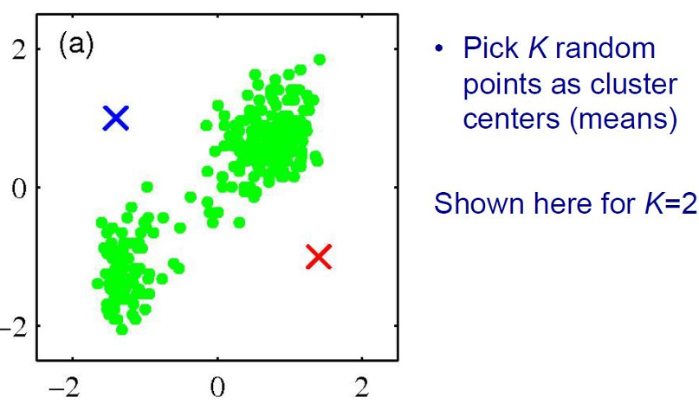
K-Means
Example

Slide 30
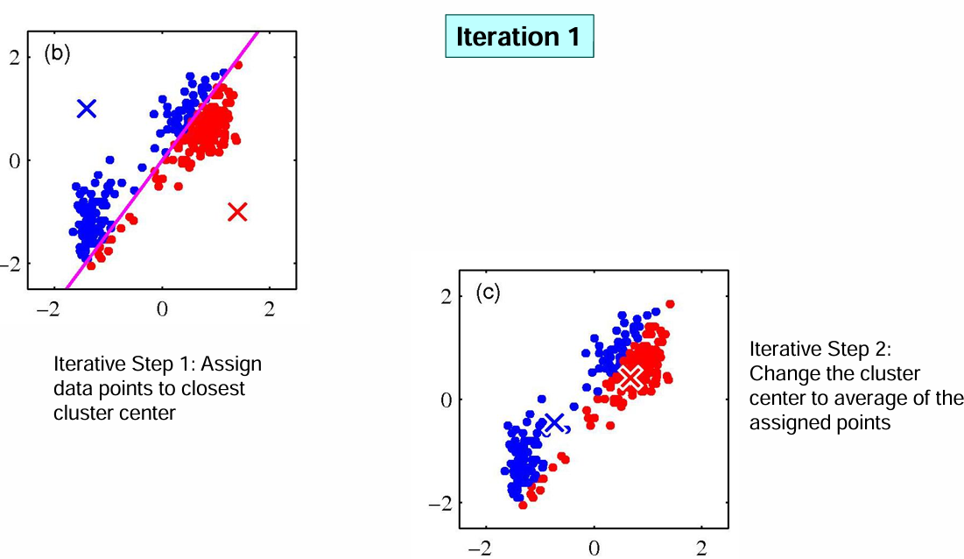
K-Means
Example

Slide 31
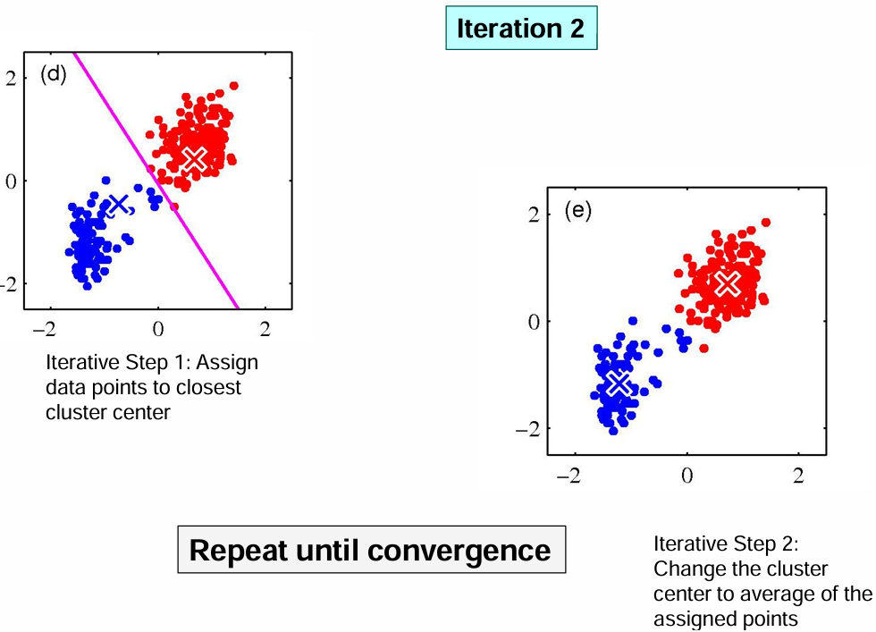
K-Means
Example

Slide 32
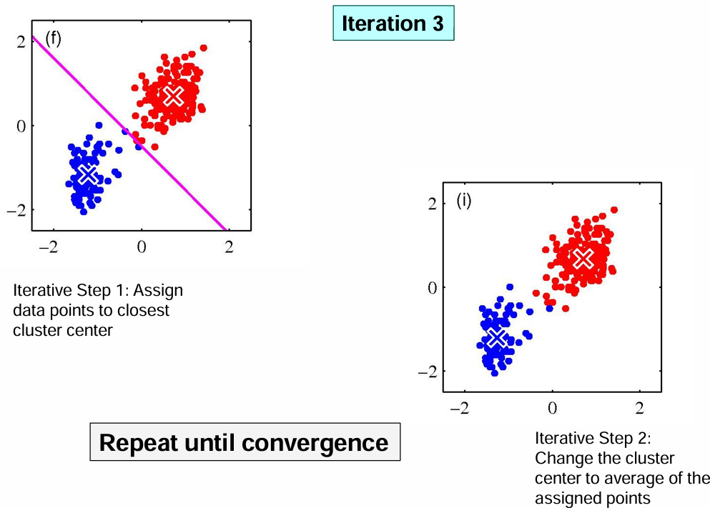
K-Means
Example

Slide 33
K-Means –Details
The centroid is (typically) the mean of the points in the cluster.
Normally, initial centroids are often chosen randomly.
Clusters produced vary from one run to another.
‘Similarity’ is measured by Euclidean distance, cosine similarity, correlation, etc
Most of the convergence happens in the first few iterations.
Often the stopping condition is changed to ‘Until relatively few points change clusters’
Some people prefer running it for ‘n’ number of iterations

Slide 34
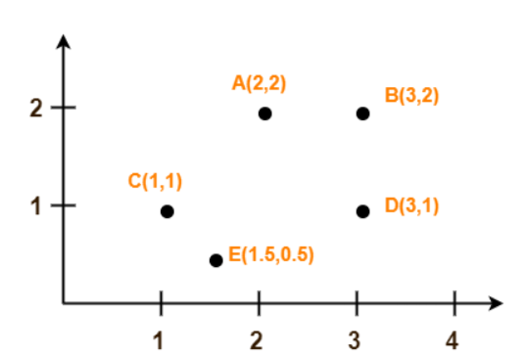
K-­‐means clustering: Example
Assume A(2, 2) and C(1, 1) are centers of the two clusters

Slide 35
K-­‐means clustering: Example
GIVEN POINTS | DISTANCE FROM C(2,2) - C1 | DISTANCE FROM C(1,1) - C2 | POINTS BELONG TO CLUSTER
A(2,2)
B(3,2)
C(1,1)
D(3,1)
E(1.5,0.5)
Assume A(2, 2) and C(1, 1) are centers of the two clusters.
Similarity measure for the above example is Euclidean Distance

Slide 36
K-­‐means clustering: Example
GIVEN POINTS | DISTANCE FROM C(2,2) - C1 | DISTANCE FROM C(1,1) - C2 | POINTS BELONG TO CLUSTER
A(2,2) | 0 | 1.41 | C1
B(3,2) | 1 | 2.24 | C1
C(1,1) | 1.41 | 0 | C2
D(3,1) | 1.41 | 2 | C1
E(1.5,0.5) | 1.58 | 0.71 | C2
Assume A(2, 2) and C(1, 1) are centers of the two clusters

Slide 37
Center of CLUSTER 01
POINTS IN CLUSTER 01:
A(2, 2)
B(3, 2)
D(3, 1)
Center of Cluster-01
= ((2 + 3 + 3)/3, (2 + 2 + 1)/3)
= (2.67, 1.67)

Slide 38
Center of CLUSTER 02
POINTS IN CLUSTER 02:
C(1, 1)
E(1.5, 0.5)
Center of Cluster-01
= ((1 + 1.5)/2, (1 + 0.5)/2)
= (1.25, 0.75)

Slide 39
K-­‐means clustering: Example
GIVEN POINTS | DISTANCE FROM C(2.67,1.67) - C1 | DISTANCE FROM C(1.25,0.75) - C2 | POINTS BELONG TO CLUSTER
A(2,2)
B(3,2)
C(1,1)
D(3,1)
E(1.5,0.5)
Assume A(2.67, 1.67) and C(1.25, 0.75) are centers of the two clusters

Slide 40
K-­‐means clustering: Example
GIVEN POINTS | DISTANCE FROM C(2.67,1.67) - C1 | DISTANCE FROM C(1.25,0.75) - C2 | POINTS BELONG TO CLUSTER
A(2,2) | 0.75 | 1.46 | C1
B(3,2) | 0.47 | 2.15 | C1
C(1,1) | 1.80 | 0.35 | C2
D(3,1) | 0.75 | 1.76 | C1
E(1.5,0.5) | 1.65 | 0.35 | C2
Assume A(2.67, 1.67) and C(1.25, 0.75) are centers of the two clusters

Slide 41
Center of CLUSTER 01
POINTS IN CLUSTER 01:
A(2, 2)
B(3, 2)
D(3, 1)
Center of Cluster-01
= ((2 + 3 + 3)/3, (2 + 2 + 1)/3)
= (2.67, 1.67)

Slide 42
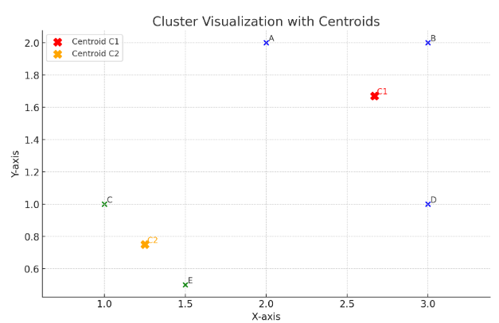
Center of CLUSTER 02
POINTS IN CLUSTER 02:
C(1, 1)
E(1.5, 0.5)
Center of Cluster-02
= ((1 + 1.5)/2, (1 + 0.5)/2)
= (1.25, 0.75)
DO WE NEED ANOTHER ITERATION????

Slide 43
Properties of K-­‐means algorithm
Guaranteed to converge in a ﬁnite number of iterations
Running time per iteration:
Assign data points to closest cluster center
O(KN) time
Change the cluster center to the average of its assigned points
O(N)

Slide 44
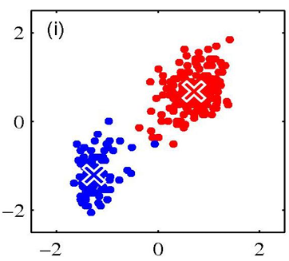
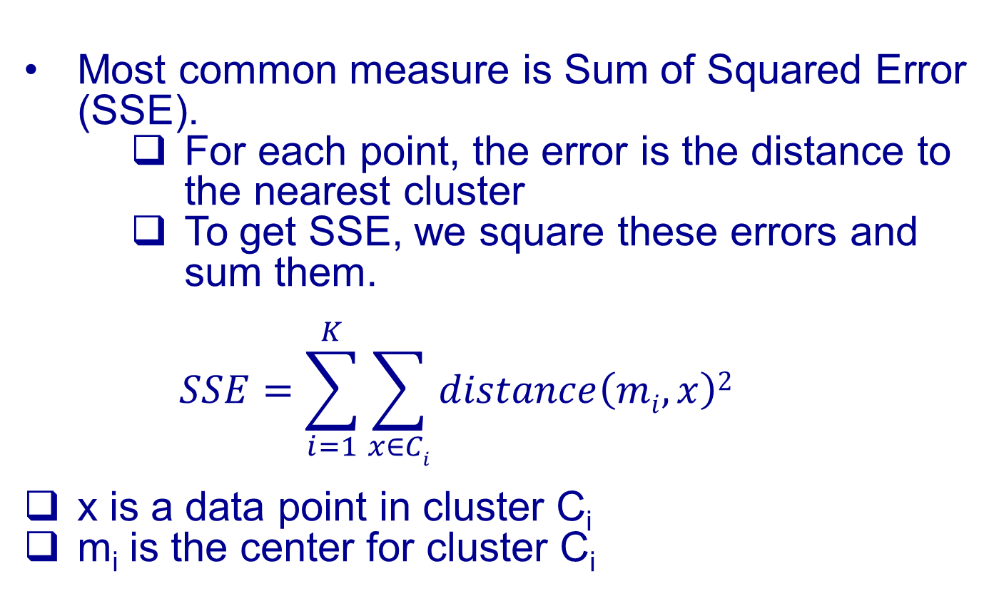
Evaluating K-means Clusters
Most common measure is Sum of Squared Error (SSE).
For each point, the error is the distance to the nearest cluster
To get SSE, we square these errors and sum them.
$$SSE=\sum_{i=1}^{K}{\sum_{x∈Ci}{distance\left(mi,x\right)2}}$$
x is a data point in cluster C_{i}
m_{i} is the center for cluster C_{i}

Slide 45
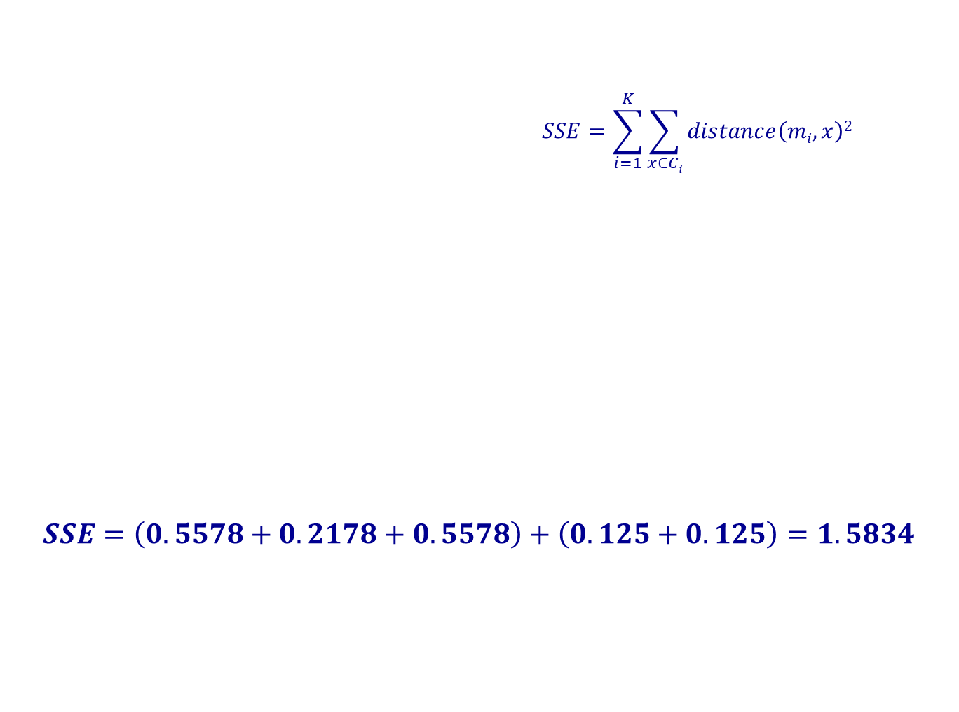
Evaluating K-means Clusters
$$SSE=\sum_{i=1}^{K}{\sum_{x∈Ci}{distance\left(mi,x\right)2}}$$
$$SSE=\left(0.5578+0.2178+0.5578\right)+\left(0.125+0.125\right)=1.5834​$$
Points in C1- Centroid (2.67, 1.67)
A(2,2) | (2−2.67)²+(2−1.67)² = (−0.67)² +(0.33)²= 0.4489+0.1089= 0.5578
B(3,2) | (3−2.67)²+(2−1.67)²=(0.33)²+(0.33)²= 0.1089 + 0.1089 = 0.2178
D(3,1) | (3−2.67)²+(1−1.67)²=(0.33)²+(−0.67)²= 0.1089 + 0.4489= 0.5578
Points in C2 - Centroid (1.25, 0.75)
C(1,1) | (1−1.25)²+(1−0.75)² =(−0.25)²+(0.25)²= 0.0625 + 0.0625= 0.125
E(1.5,0.5) | (1.5−1.25)²+(0.5−0.75)²=(0.25)²+(−0.25)²=0.0625+0.0625=0.125

Slide 46
Evaluating K-means Clusters
Given two clusters, we choose the one with the smallest error
One easy way to reduce SSE is to increase K, the number of clusters
A good clustering with smaller K can have a lower SSE than a poor clustering with higher K

Slide 47
Evaluating K-means Clusters
Given two clusters, we choose the one with the smallest error
One easy way to reduce SSE is to increase K, the number of clusters
A good clustering with smaller K can have a lower SSE than a poor clustering with higher K

Slide 48

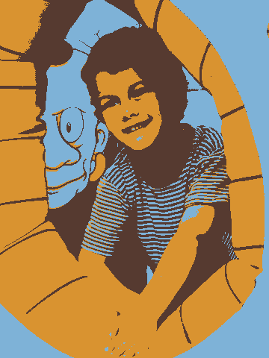
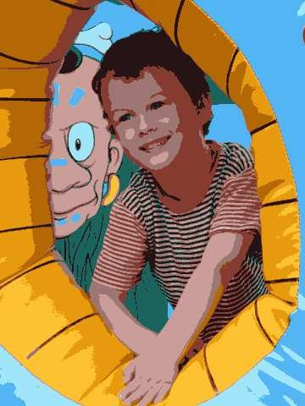
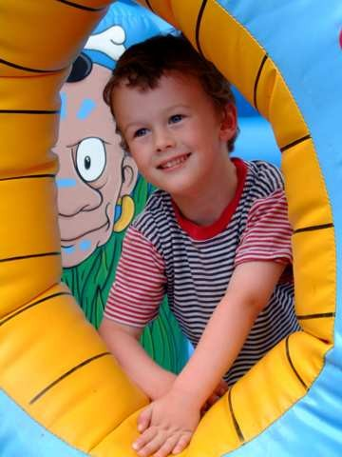

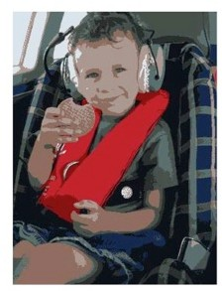
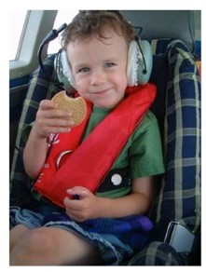
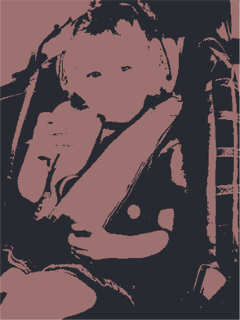
Example: K-Means for Segmentation
K=2
Original
K =2
Goal of Segmentation is
K =3 K = 10
Original image
to partition an image into regions each of which has reasonably homogenous visual appearance.

Slide 49
Example: K-Means for Segmentation
K=2
K=3
K=10
Original
K =2
K =3
K = 10
Original image

Slide 50
Example: K-Means for Segmentation
K=2
K=3
K=10
Original
K =2
K =3
K = 10
Original image
4%
8%
17%

Slide 51

Initialization
K-means algorithm is a heuristic
Requires initial means
It does matter what you pick!
What can go wrong?
Various schemes for preventing this kind of thing: variance-based split / merge, initialization heuristics

Slide 52

K-Means Getting Stuck
A local optimum:
Would be better to have one cluster here
… and two clusters here

Slide 53









K-means not able to properly cluster
Y
X

Slide 54
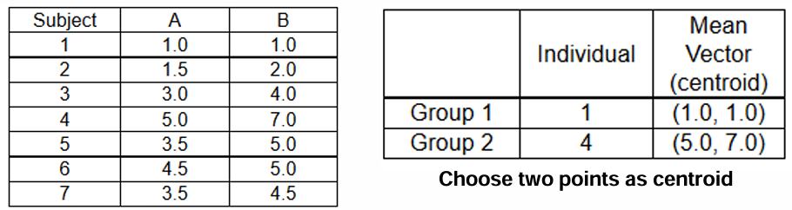
Class Activity 9
Q1. Run two iterations with Euclidean Distance
Q2. Run two iterations with Manhattan distance

Slide 55
Extra
K-­‐means Applets:
http://home.dei.polimi.it/matteucc/Clustering/ tutorial_html/AppletKM.html
http://www.cs.washington.edu/research/ imagedatabase/demo/kmcluster/

